Slide 1
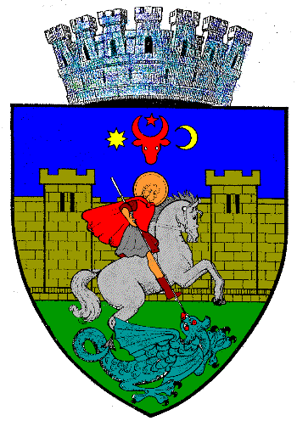
SMART CITY – SUCEAVA
City of Suceava
Dan Dura
Project manager

Slide 2
City of Suceava–Smart City Developments
Regional and local dissemination meetings – trough URBACT and INTERREG projects
SUMP and Local Integrated Development Strategy – delivered in April 2017 – with actions related smart solution replication
Public consultation with local stakeholders related GrowSmarter replication measures – September 2017
13EVs, 2 electric utility vehicles, 10 E bikes and 28 charging points – second half on 2017
Public lighting rehabilitation –LED systems – 4311 units already installed

Slide 3
Low Energy Districts – Smart Measure Replication
1.1 - Energy efficient refurbishment of the building-Efficient and smart climate shell refurbishment of residential buildings - Barcelona
2.1 Integrated multimodal transport for construction materials -Construction consolidation centre – Stockholm
3.1 Active House/Home energy management system/Smart home system - Home Energy Management – Cologne and Home Energy Management System (HEMS) – Barcelona
4.2 Smart energy and self-sufficient block -Smart LED street lighting and Combined electrical charging and street lighting poles + Wi-Fi-to-grid connection – Stockholm
10.1 Traffic management through MFD - Smart traffic signals – Stockholm and Barcelona
11.1 Developing charging infrastructure –Normal and Fast charging infrastructure for electric vehicles – Stockholm

Slide 4
Integrated Infrastructure – Smart Measure Replication
1.1 - Energy efficient refurbishment of the building-Efficient and smart climate shell refurbishment of residential buildings - Barcelona- Rehabilitation of Town Hall building using ERDF funds – 1.373.433 Euro – implementation phase
2.1 Integrated multimodal transport for construction materials -Construction consolidation centre – Stockholm – Integrated Action Plan – available since march 2018 - for implementation of this smart solution

Slide 5
Integrated Infrastructure – Smart Measure Replication
3.1 Active House/Home energy management system/Smart home system - Home Energy Management – Cologne and Home Energy Management System (HEMS) – Barcelona- technical documentation are prepared for rehabilitation of residential and public buildings in order to apply for ERDF/ central govern funding
4.2 Smart energy and self-sufficient block -Smart LED street lighting and Combined electrical charging and street lighting poles + Wi-Fi-to-grid connection – Stockholm - LED systems for public lighting – 4311 installed , municipal EV’S – 11 cars , 2 vans and 2 utility vehicles – functional, LED systems for education units – 9221 – implementation phase

Slide 6
Integrated Infrastructure – Smart Measure Replication
10.1 Traffic management through - Smart traffic signals – Stockholm and Barcelona – SUMP and IDS finalized , technical documentation ( including traffic studies ) are prepared in order to apply for ERDF funding
11.1 Developing charging infrastructure –Normal and Fast charging infrastructure for electric vehicles – Stockholm – 14 fast and 14 standard – functional , charging infrastructure for e - bikes ( using photovoltaic panels ) - functional

Slide 7
Wild card – any other relevant issue to communicate
Starting from January 2017 Suceava Municipality is partner in INTERREG project called MOLOC _ ”Low carbon urban morphology. New urban morphologies, new governances, new challenges for cities in energy transition”. Trough this new project in the next 3 years a Local Integrated Plan will be developed for Suceava City with measures regarding energy efficiency in resediential and public buildings . This new Plan will be used for future application in order to secure funding for implementation of energy efficiency projects .
5 Local , regional and transnational Meetings organized as part of MOLOC project with the Local Support Group in order to disseminate informations related to energy saving behaviour , equipments and technologies .

